Slide 1
CPE 404
Computer Hardware Design
Dr Osama Hosameldeen
Spring 2021
Lecture 14
Memory Systems – Dynamic RAM

Slide 2
Topics
Random Access Memory
  Static RAM
  Array of RAM ICs
  Dynamic RAM
  Types of Dynamic RAM
Comparison
Larger Wider Memories
Notes:
School of Engineering

Slide 3
Memory Expansion

Slide 4
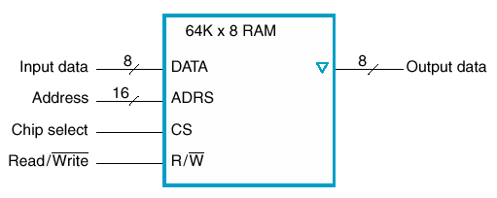
Larger/Wider Memories
Made up from sets of chips
Consider a 64K by 8 RAM
  Note new symbols for sets of lines, 8 & 16 bits wide
The “Chip Select” line will activate the memory chip
How to increase capacity to 256K x 8?
  (# of Address Lines?)
This indicates tri-state capability
Recall 2¹⁰ = 1024, 2¹¹ = 2048, ….
16 address lines → 2¹⁶ = 64K
17 address lines → 2¹⁷ = 128K
18 address lines → 2¹⁸ = 256K
How many chips are required to expand?
How do we connect these chips together?

Slide 5
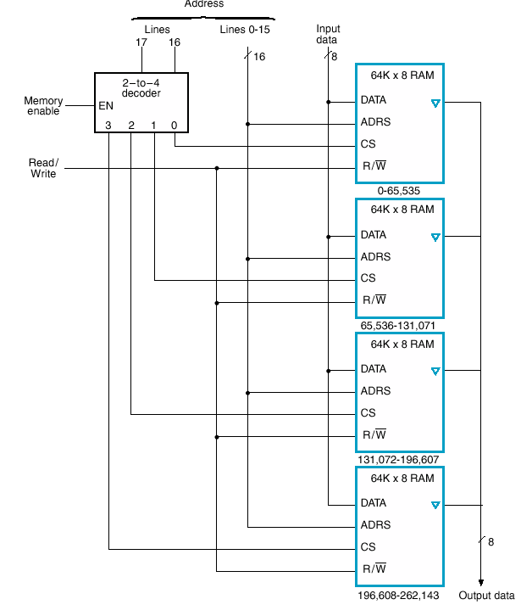
Larger: 256k x 8
Use 4 of these chips → 256 K x 8
Connect all output data lines together (tristate)
Connect all input data line together
Connect all 16 address lines together (i.e., 16 lines of address to fetch a word in any DRAM chip)
But we need to activate only one chip at a time!!
How many address lines for 256K Memory?
How to select the specific RAM chip?
?
?
?
?

Slide 6
Larger Capacity
Decoder for high-order 2 bits
  Selects chip
Check the address ranges

Slide 7
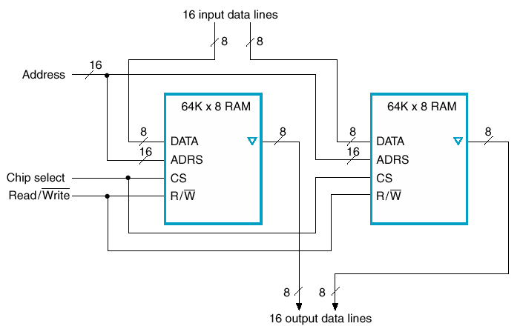
Wider Memory – 64K X 16

Slide 8
Larger/Wider Memories
Based on the 64K x 8 RAM shown below:
  Increase the capacity to 256K.
  Extend the width of the memory to 16 bits
In other words create a 256K x 16 Memory.

Slide 9
Dynamic RAM

Slide 10
Dynamic Memory
Dynamic memory is built with capacitors.
  A stored charge on the capacitor represents a logical 1.
  No charge represents a logic 0.
However, capacitors lose their charge after a few milliseconds. The memory requires constant refreshing to recharge the capacitors. (That’s what’s “dynamic” about it.)
Dynamic RAMs tend to be physically smaller than static RAMs.
  A single bit of data can be stored with just one capacitor and one transistor, while static RAM cells typically require 4-6 transistors.
  This means dynamic RAM is cheaper and denser—more bits can be stored in the same physical area.

Slide 11
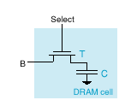
Dynamic RAM
Capacitors can hold charge
Transistor acts as gate
  No charge is a 0
  Can close switch & add charge to store a 1
Then open switch (disconnect)

Slide 12
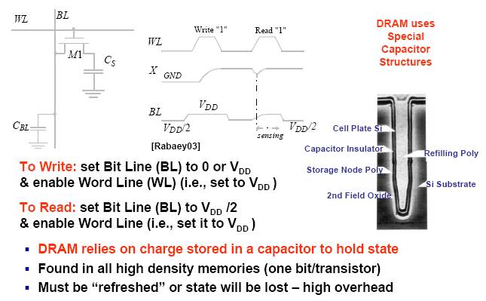
DRAM Cell

Slide 13
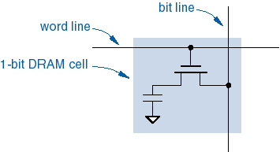
DRAM Read Operations
  Pre-charge bit line to V_{DD}/2.
  Take the word line HIGH.
  Detect whether current flows into or out of the cell.
  Note: cell contents are destroyed by the read!
  Must write the bit value back after reading.

Slide 14
DRAM Write Operations
  Take the word line HIGH.
  Set the bit line LOW or HIGH to store 0 or 1.
  Take the word line LOW.
  Note: The stored charge for a 1 will eventually leak off.

Slide 15
Dynamic RAM (… continued)
Select
Stored 1
Stored 0
T
To Pump
B
C
DRAM cell
(a)
(b)
(c)
Write 1
Write 0
(d)
(e)
Read 1
Read 0
(f)
(g)
Notes:
School of Engineering
Warning: (d), (e), (f), and (g) are animated. Each animation is triggered with a mouse click
and goes through two steps at 1 second intervals.

Slide 16
DRAM Characteristics (Why Slow!)
Destructive Read
  When cell read, charge removed
  Charge must be restored after a read
Refresh
  Capacitors are not perfect! there’s steady leakage
  Charge must be restored periodically
DRAM are dense (lots of cells) so there are many address lines.
  To reduce the physical size of DRAM we can reduce the number of pins by applying the address lines serially in two parts:
    Row Address, and then
    Column Address

Slide 17
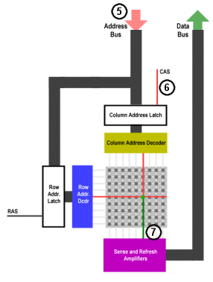
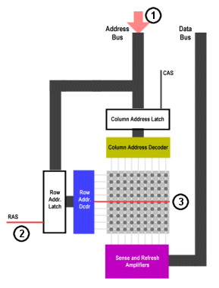
How DRAM Works
A₇A₆A₅A₄A₃A₂A₁A₀
A₇A₆A₅A₄
A₃A₂A₁A₀

Slide 18
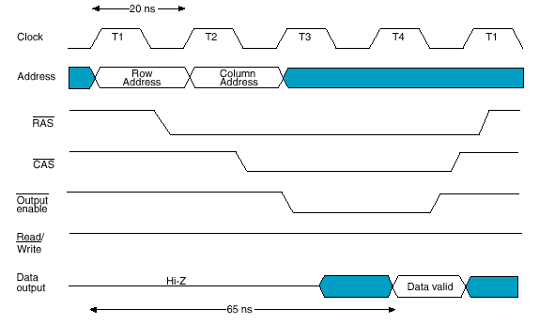
DRAM Read Signaling
DRAM has a lower pin count by using same pins for row and column addresses
Delay until data available

Slide 19
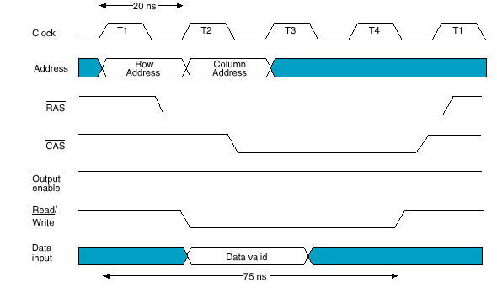
DRAM Write Timing

Slide 20
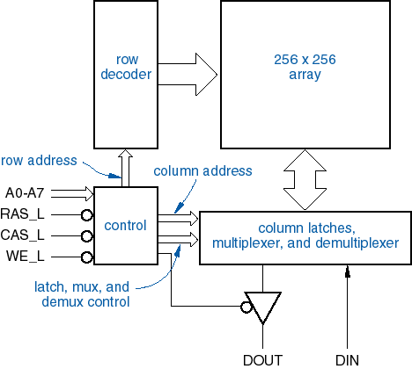
DRAM-chip Internal Organization
64K x 1
DRAM

Slide 21
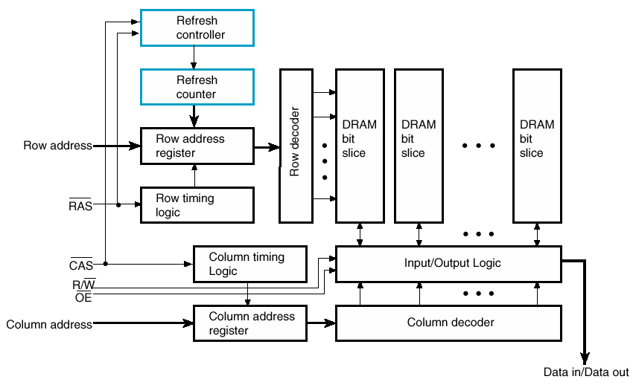
DRAM Logic Diagram

Slide 22
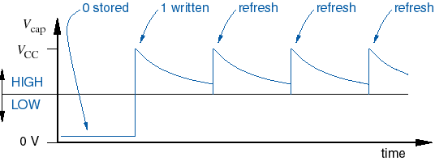
DRAM Charge Leakage
Typical devices require each cell to be refreshed once every 4 to 64 mS.

Slide 23
DRAM Refresh
Many strategies
Logic on chip
Refresh counter and Refresh controller
Refresh counter is used to provide the address of the row of DRAM cell to be refreshed.

Slide 24
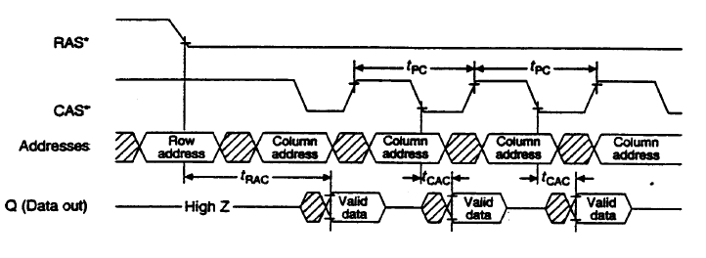
CAS Before RAS
Set column address
Apply CAS first (opposite of RW)
Then toggle RAS enough times to cycle through row addresses
On-board refresh counter applies the row addresses
CAS
RAS
Col Add
Row Add
Row Add
Row Add
Row Add

Slide 25
DRAM Chip Types
DRAM - Dynamic RAM
FPM RAM - Fast page-mode RAM
EDO RAM - Extended Data Out RAM
BEDO RAM - Burst Extended-data-out RAM
SDRAM - Synchronous Dynamic RAM
DDRRAM - Double Data Rate RAM

Slide 26
Page Mode DRAM
DRAMs are made to read & write blocks
Example
  Assert RAS, leave asserted
  Assert CAS multiple times to read sequence of data
Similar for writes

Slide 27
Synchronous DRAM

Slide 28
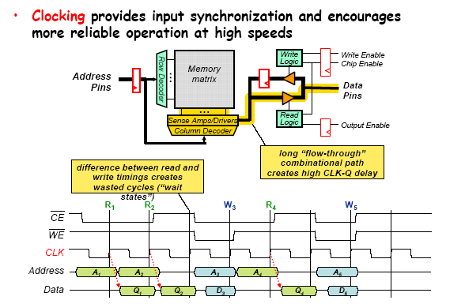
Synchronous DRAM (SDRAM)
Double Data Rate SDRAM
Transfers data on both edges of the clock

Slide 29
DRAM Evolution
There has been multiple improvements to the DRAM design in the past 20 years.
  SDRAM: A clock signal was added making the design synchronous. Transfer data on rising edge of clock.
  DDR SDRAM: The data bus transfers data on both rising and falling edge of the clock.
  DDR2 SDRAM: Second generation of DDR memory scales to higher clock frequencies.
  DDR3 SDRAM: Third generation has lower power consumption, higher clock frequency and denser modules
  DDR4 SDRAM: Fourth generation, improvement over DDR3, high bandwidth, higher speed. However it is not compatible with any earlier type of (RAM) due to different signaling voltages.

Slide 30
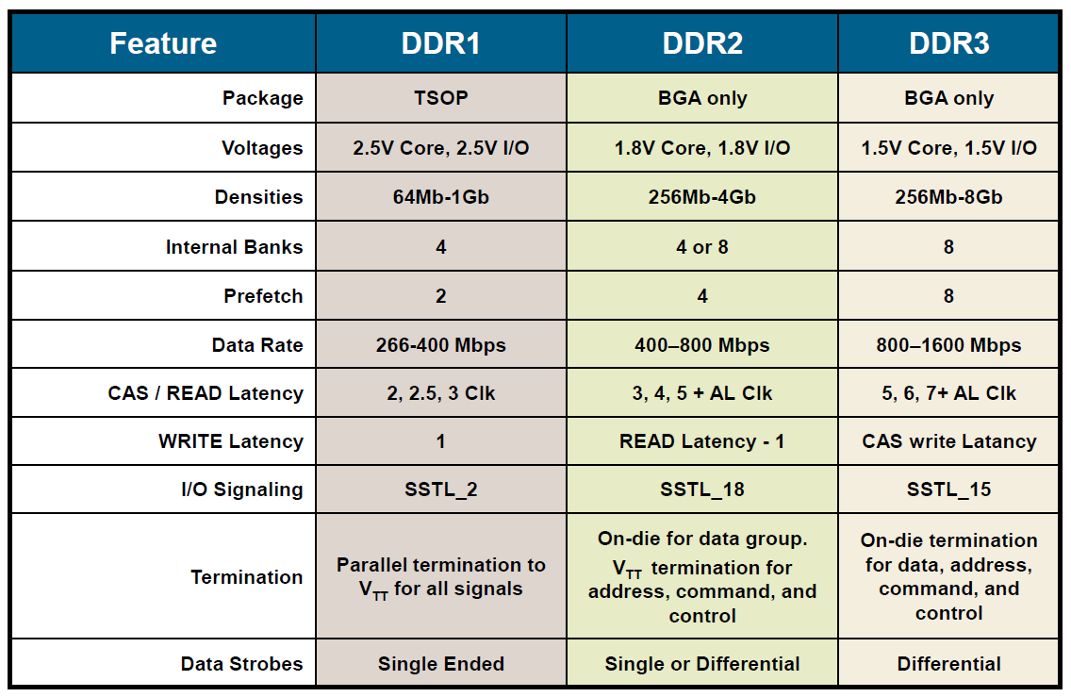
DDR SDRAM Comparison

Slide 31
Memory Technologies: Summary
DRAM: Dynamic Random Access Memory
  upside: very dense (1 transistor per bit) and inexpensive
  downside: requires refresh and often not the fastest access times
  often used for main memories
SRAM: Static Random Access Memory
  upside: fast and no refresh required
  downside: not so dense and not so cheap
  often used for caches

Slide 32
Summary
RAMs with different characteristics
  For different purposes
Static RAM
  Simple to use, small, expensive
  Fast, used for cache
Dynamic RAM
  Complex to interface, largest, cheap
  Needs periodic refresh
  Dense, slow, used in Main Memory

Slide 33
Links
Ram:
  https://www.youtube.com/watch?v=PVad0c2cljo
  http://arstechnica.com/paedia/storage.html
  https://www.youtube.com/watch?v=0rNEtAz3wJQ
  https://www.youtube.com/watch?v=yi0FhRqDJfo
  http://islab.soe.uoguelph.ca/sareibi/TEACHING_dr/ENG241_html_dr/outline_FALL_20xx/links.html

Slide 34
Lecture End

